Slide 1
Wave Literature
Company Profile

Slide 2
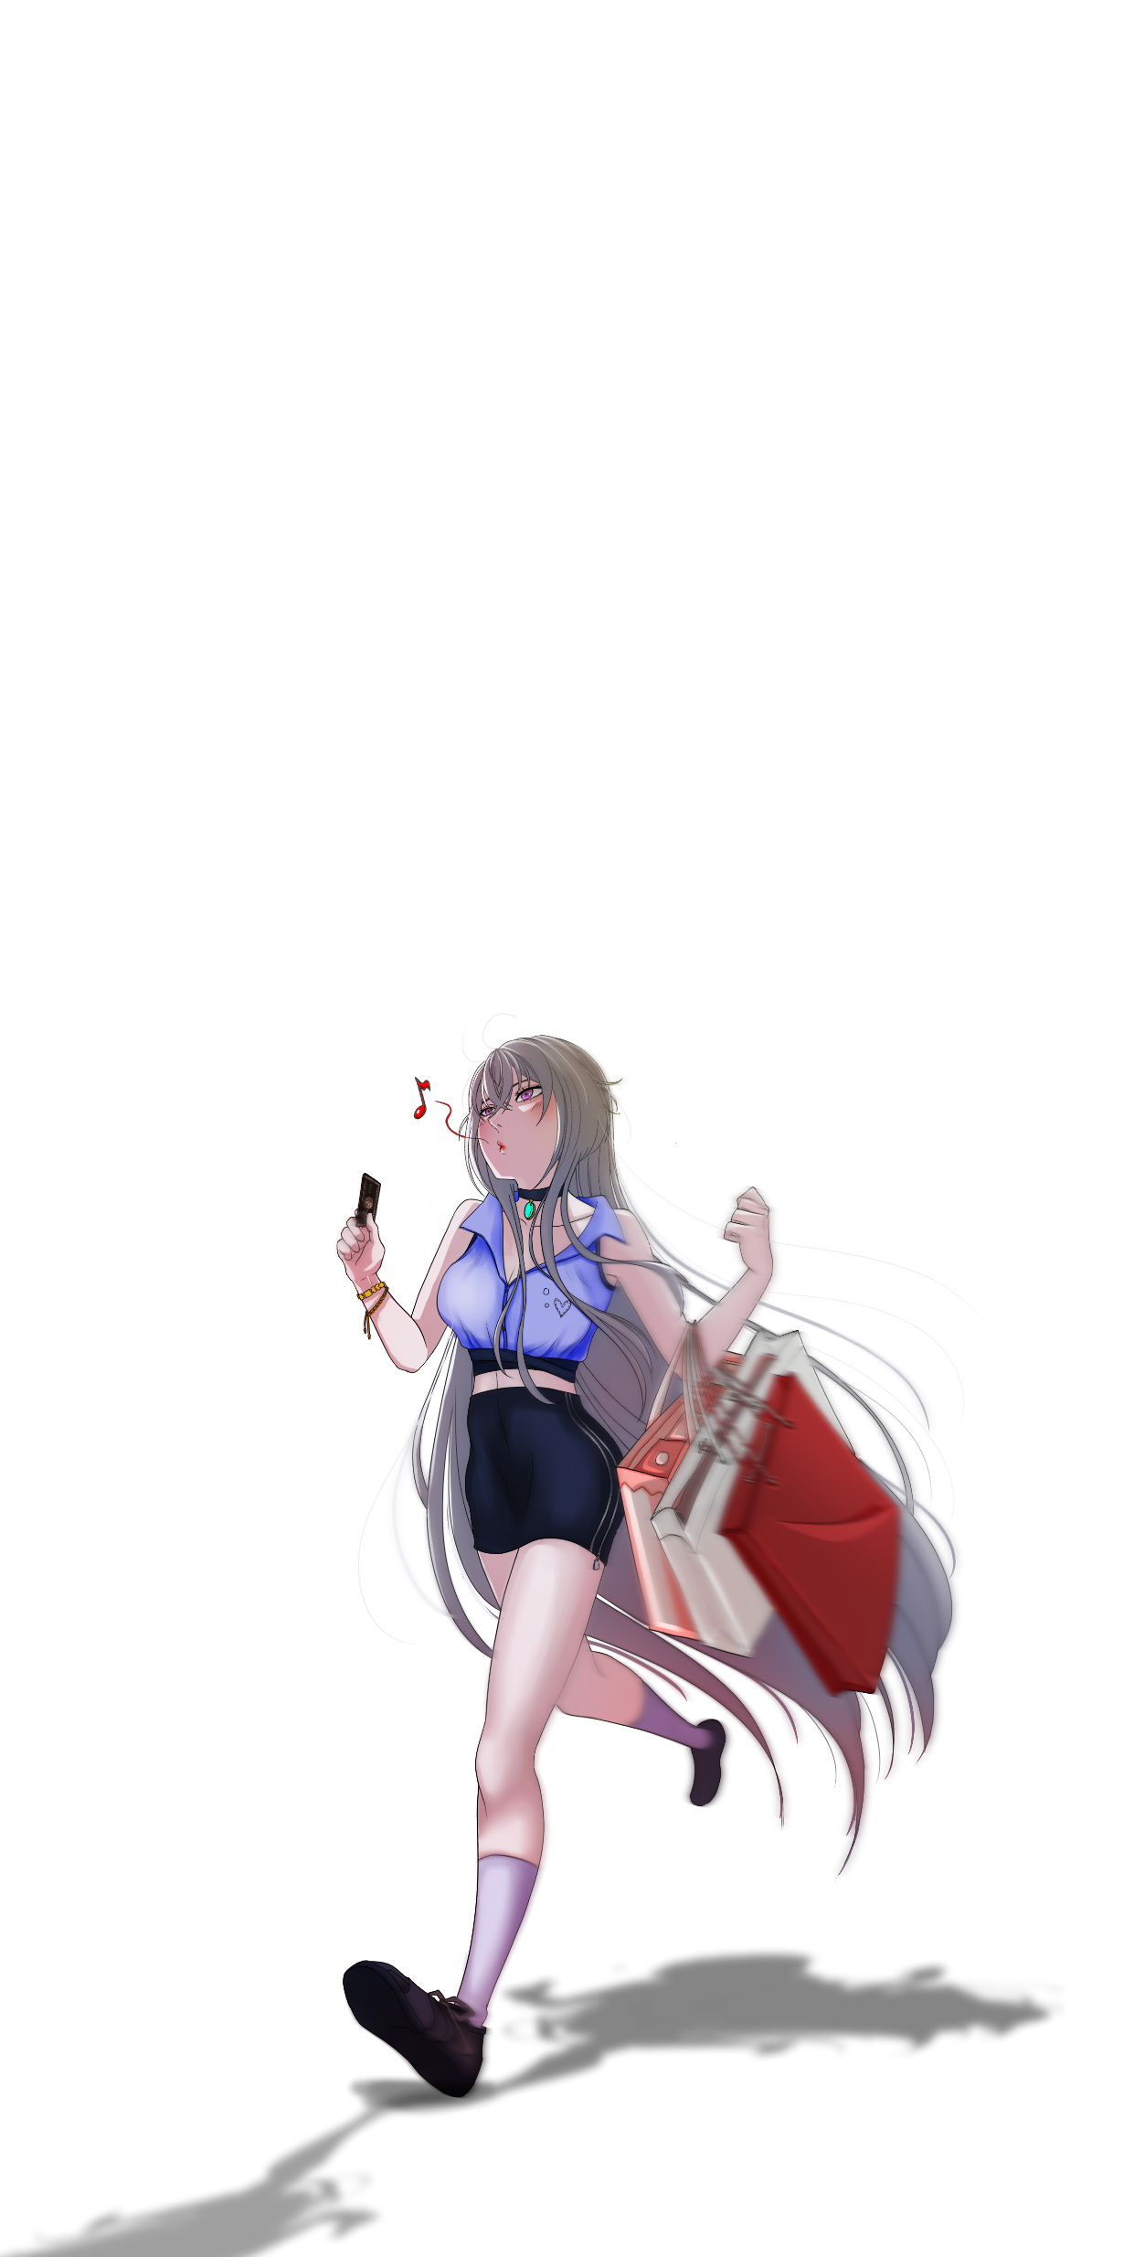
Content List
01 | Wave Literature Introduction
02 | Comic Production Process
03 | Novel & Comic, Game Localization

Slide 3
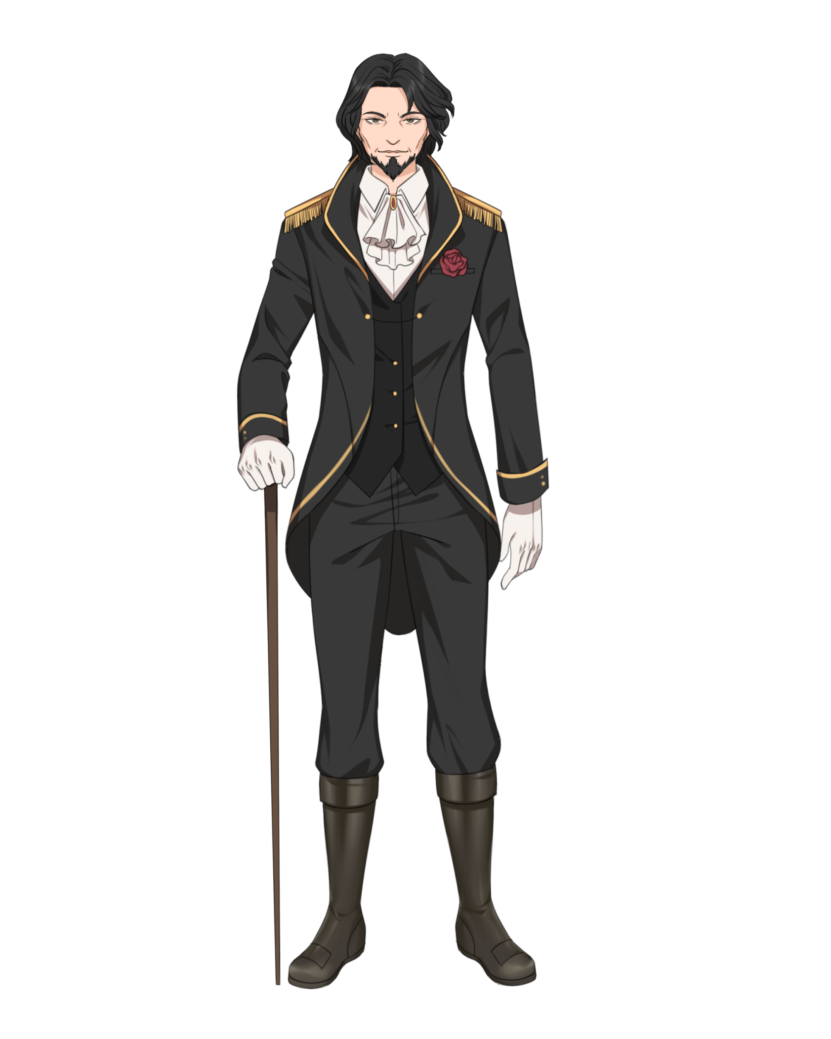
Wave Literature Introduction
Establish | October 2018
Address | Kayoon 24, Surabaya, Indonesia
Employee | 150+ people and growing
Business Field | Novel + Comic Production Agency

Slide 4
01 |
Wave Literature Introduction
CEO + COO
1. Marketing & Community
2. Translation
3. Comic
Production
4. Author Management
Field (Offline)
CN, EN, KR, JP → ID, VN, TH
CN → EN
Script & Storyboard
Character Design
Recruits & Train Author
Online (FB, IG, WA, Tiktok, etc)
Novel
Novel
Line Art Drawing
Author Relationship
Comic
Comic
Base Coloring
Game
Game
Finishing

Slide 5
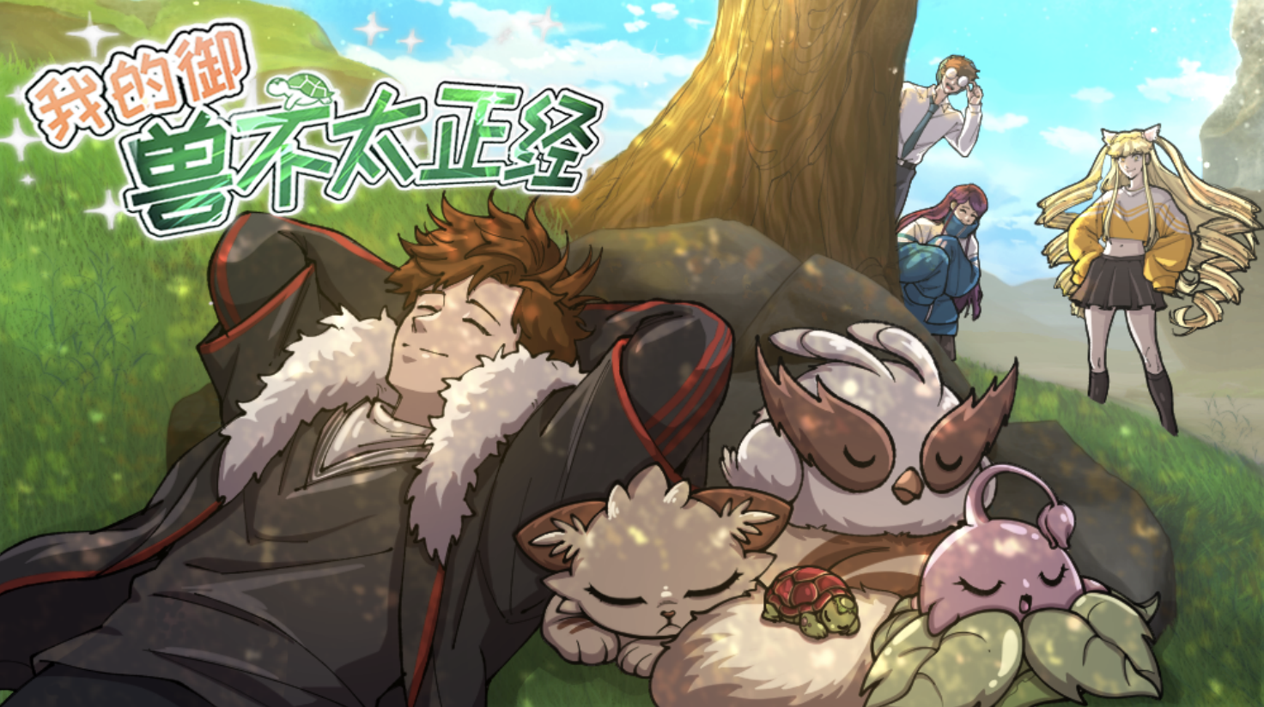
Comic Production

Slide 6
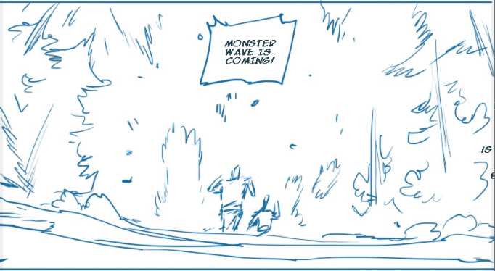
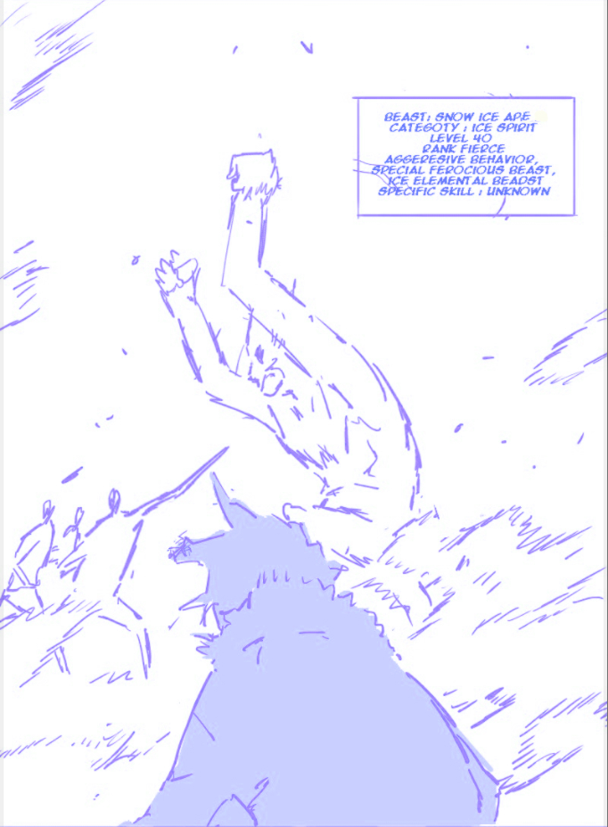
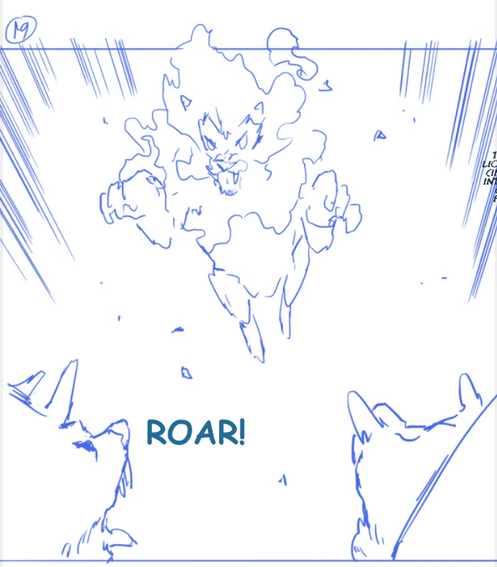
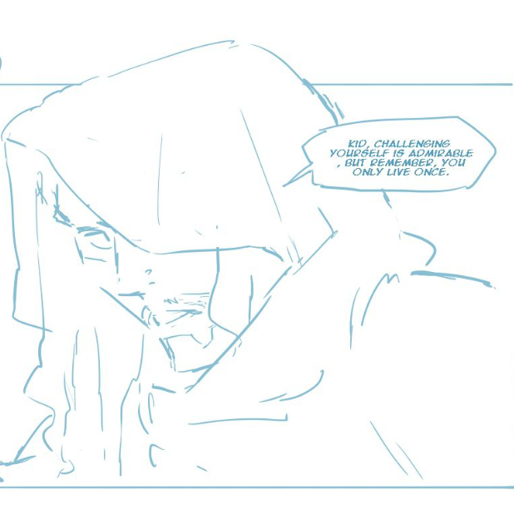
Storyboarding
Action
Cinematic
Drama
Fighting Sequence
Fantasy

Slide 7
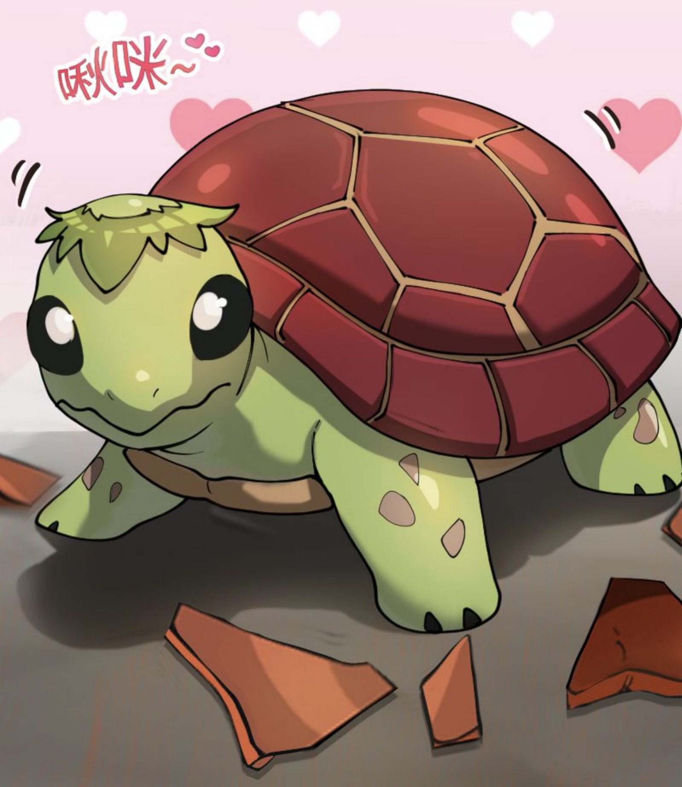
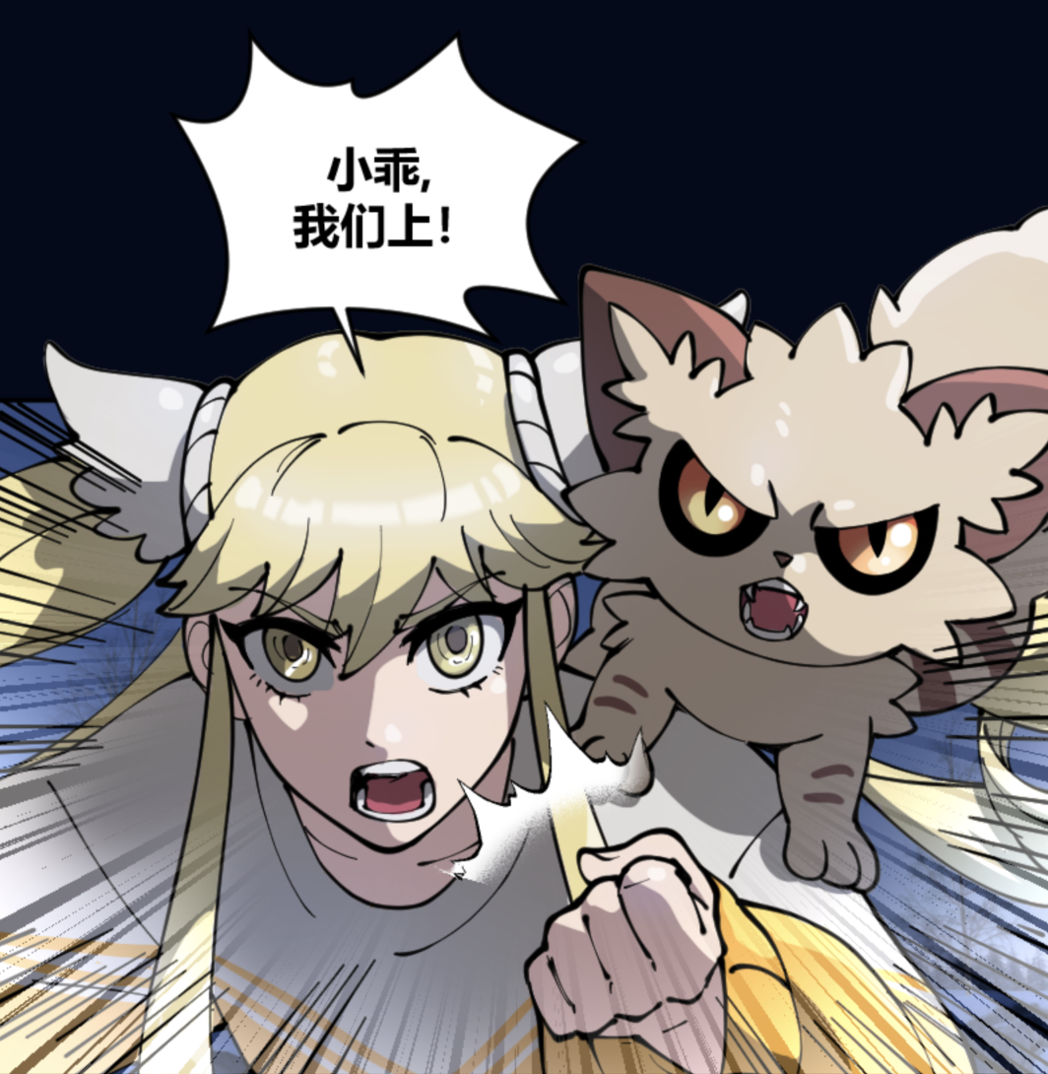
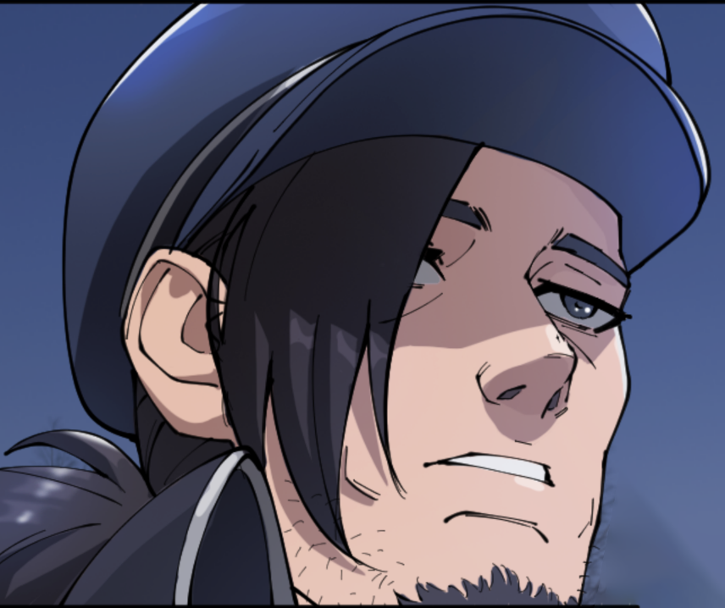
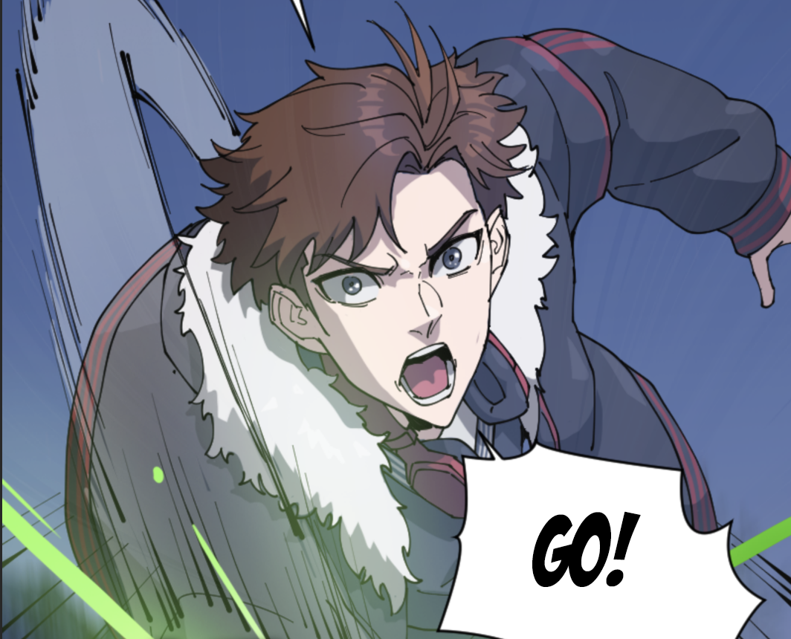
Character Design
Changsi
A cute pet turtle hatched from a magical egg
Su Nianqing and Mr. Owl
Strong willed female character Su Nian with her pet owl
General Yu
In the academy he is known to be cold and straightforward, yet he is actually very caring towards his students
Cheng Feng
18 years old, Cheng Feng is assigned to his first patrol. In the middle of the night,
he and his team is ambushed.

Slide 8
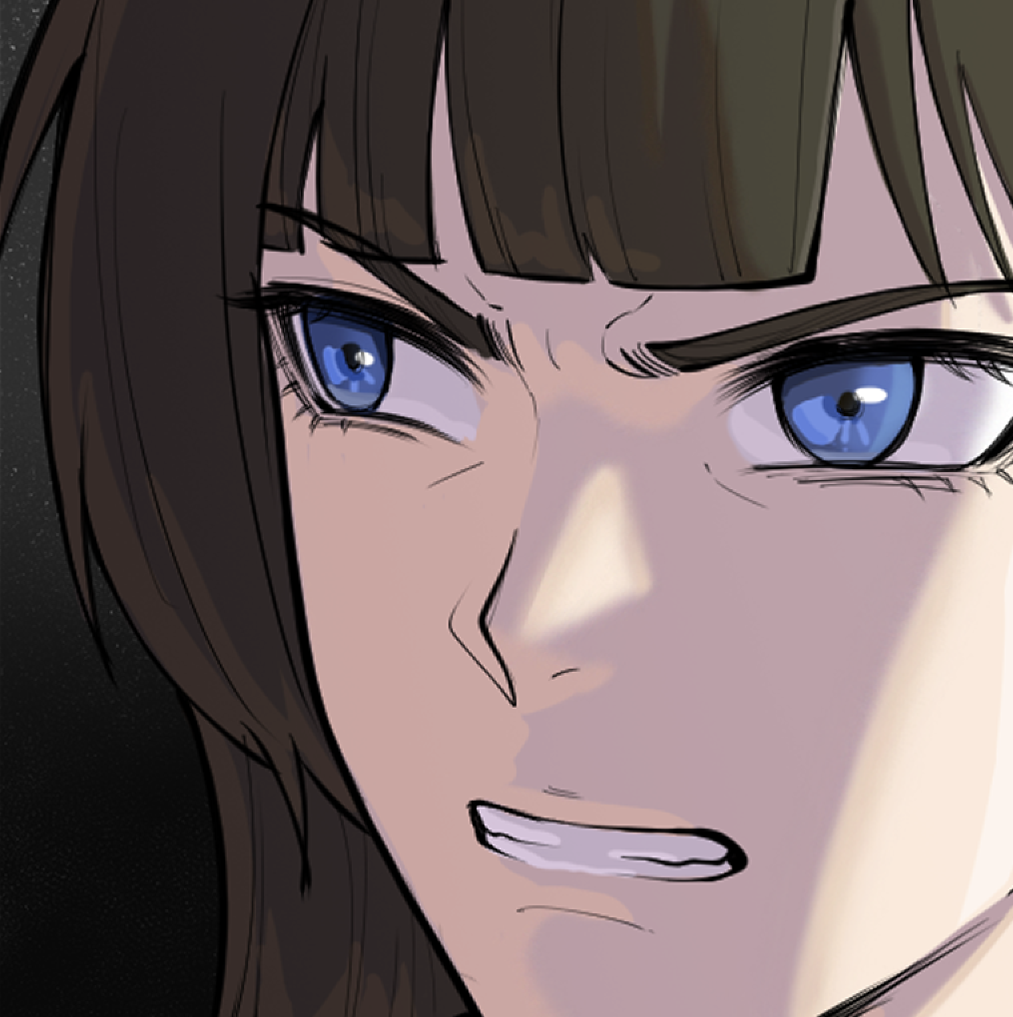
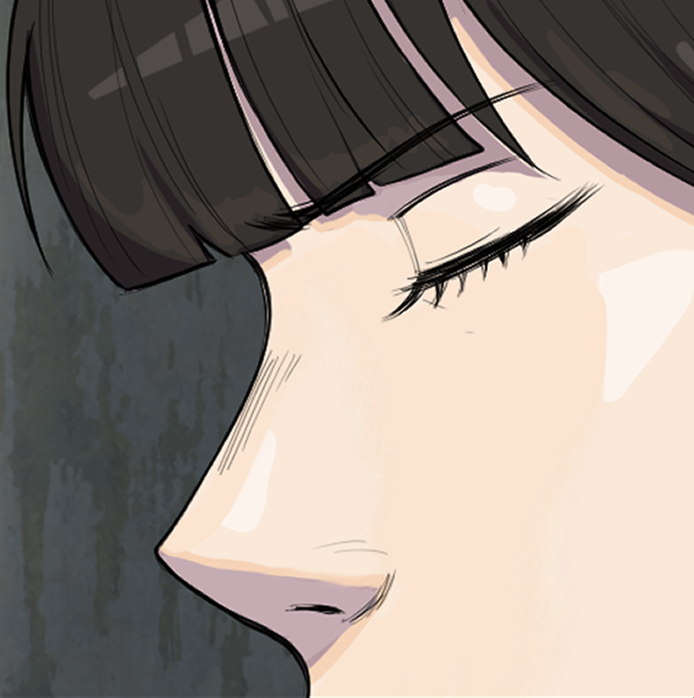
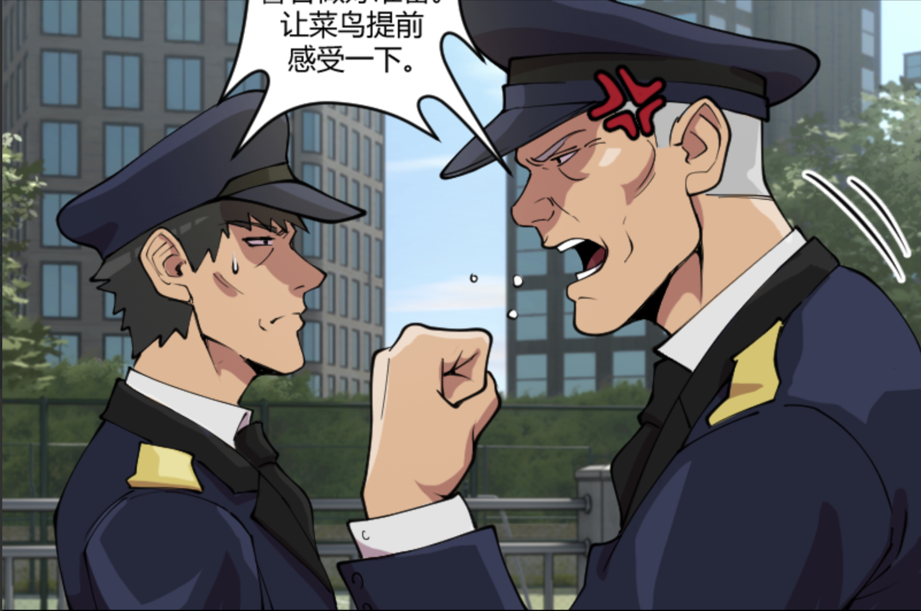
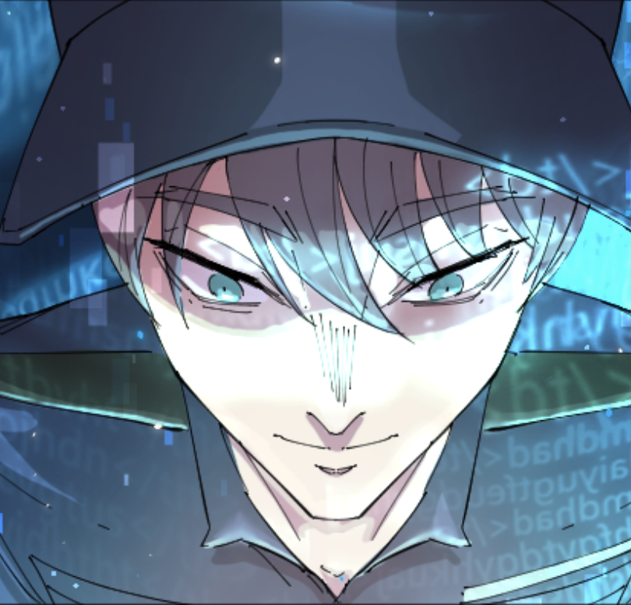
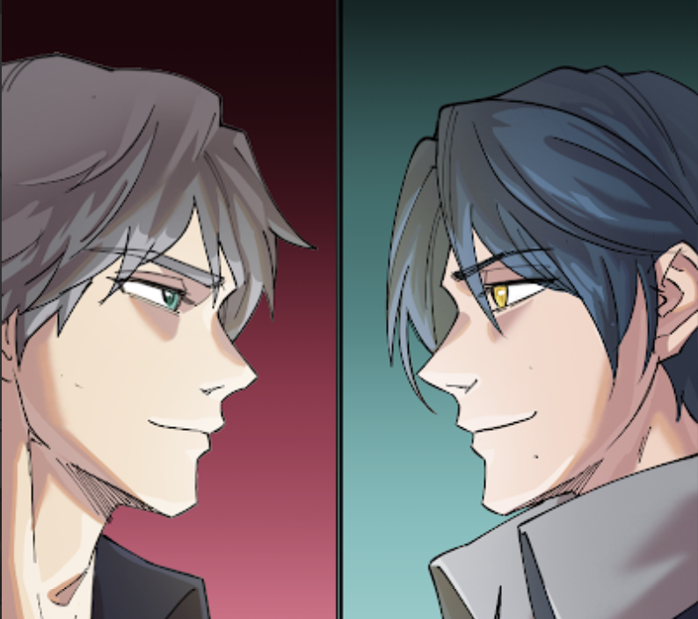
Character Design
TingYun
An attractive 21 years old police woman who often becomes the object of imagination of men in her workplace.
Chief Wei and Sergeant Wang
Temperamental Chief Wei is often angry with his subordinates. He is unreasonable and demands perfection from his men.
Jian Yu
Our main character comes from the future and has access to future technology.
Brother Cheng
Our protagonist main rival brother Cheng also comes from the future

Slide 9
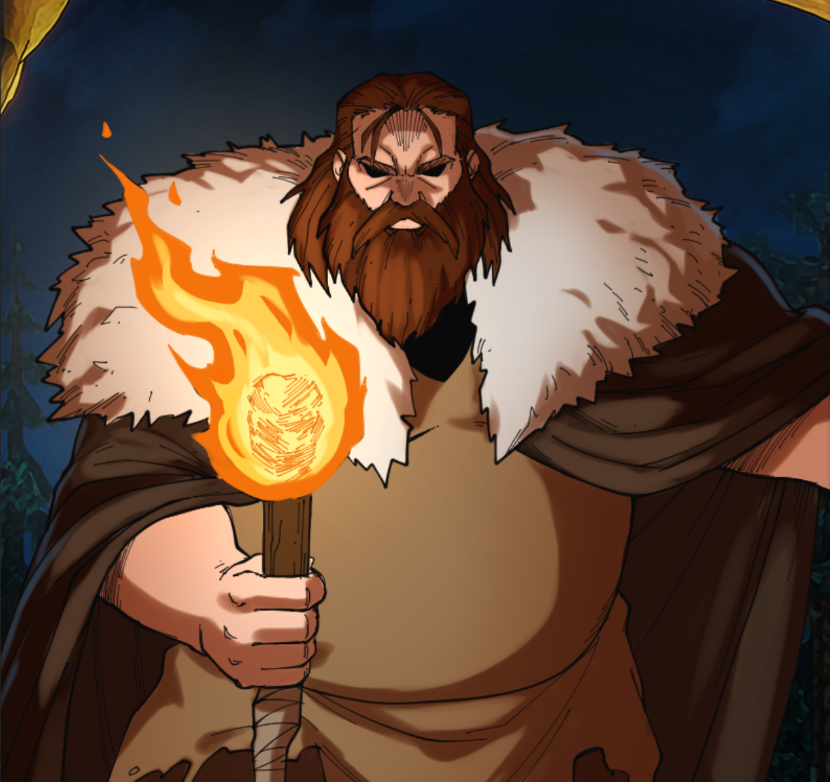
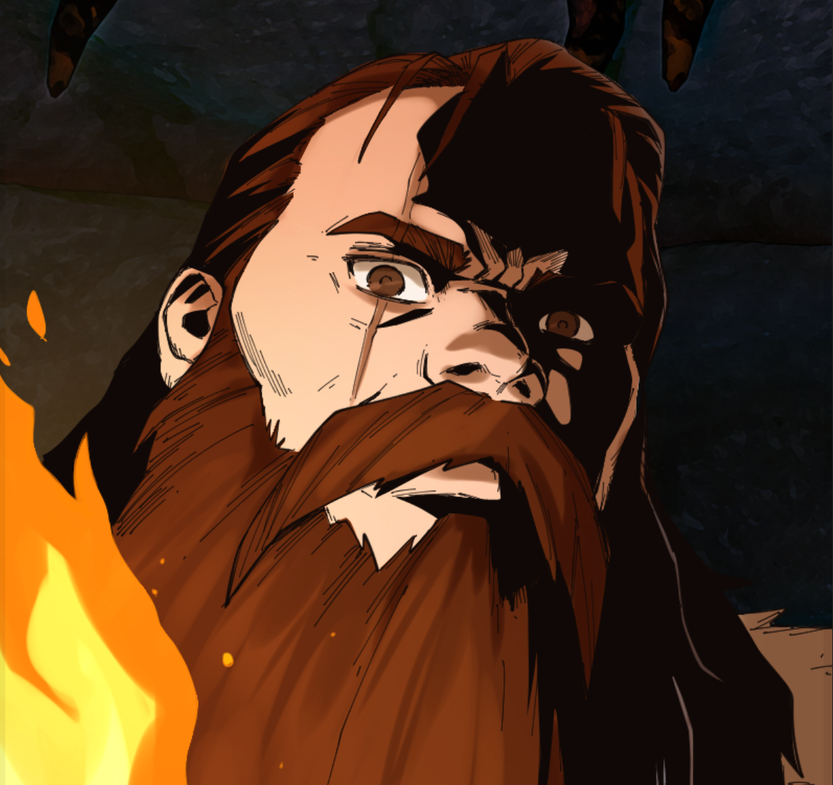
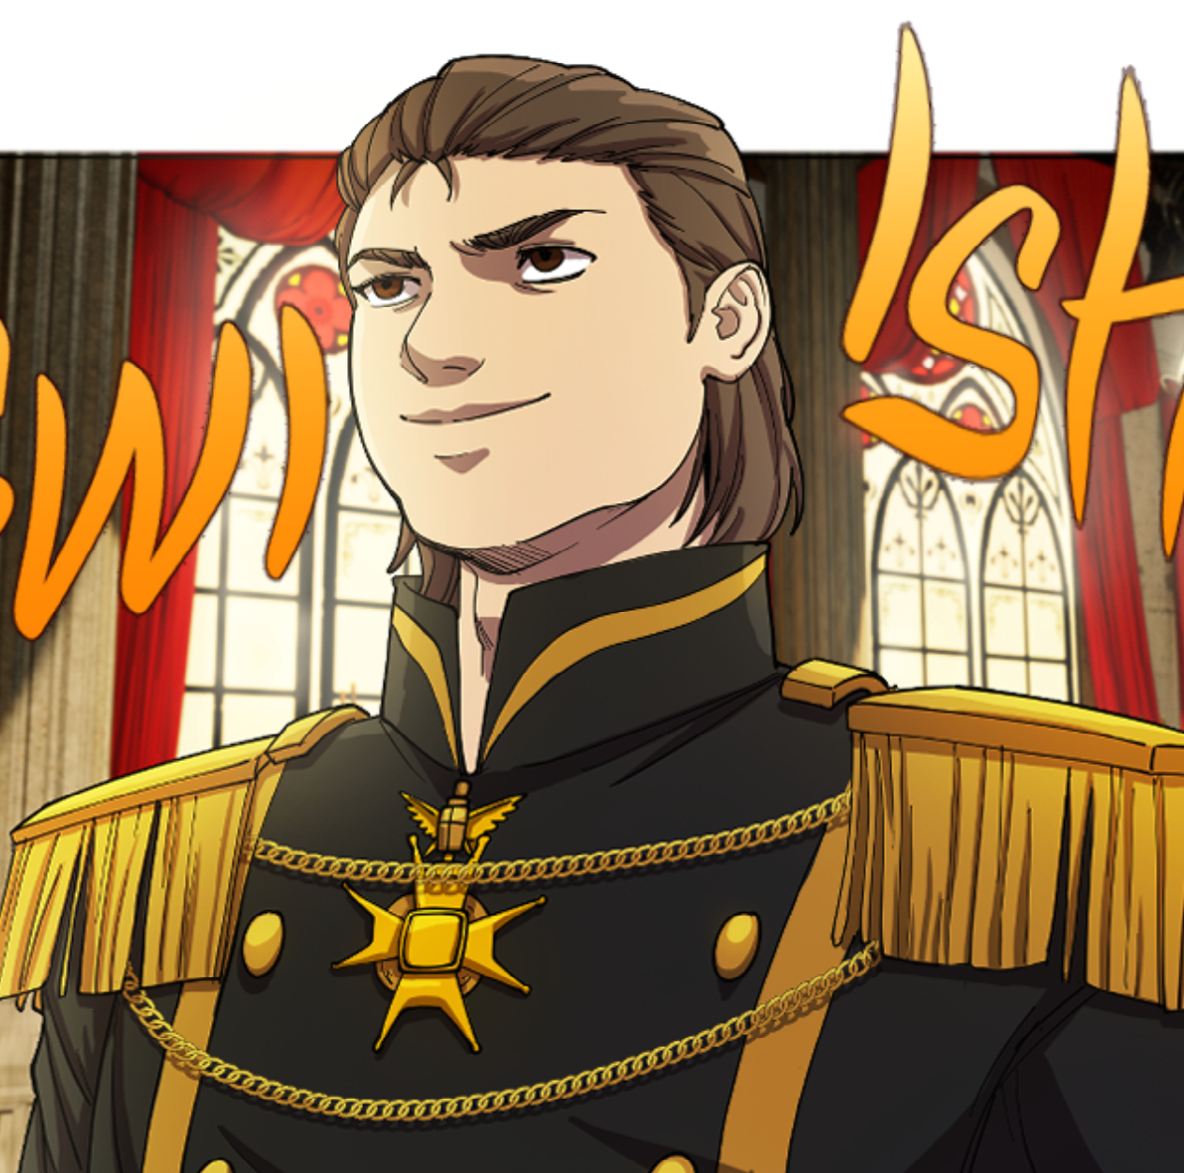
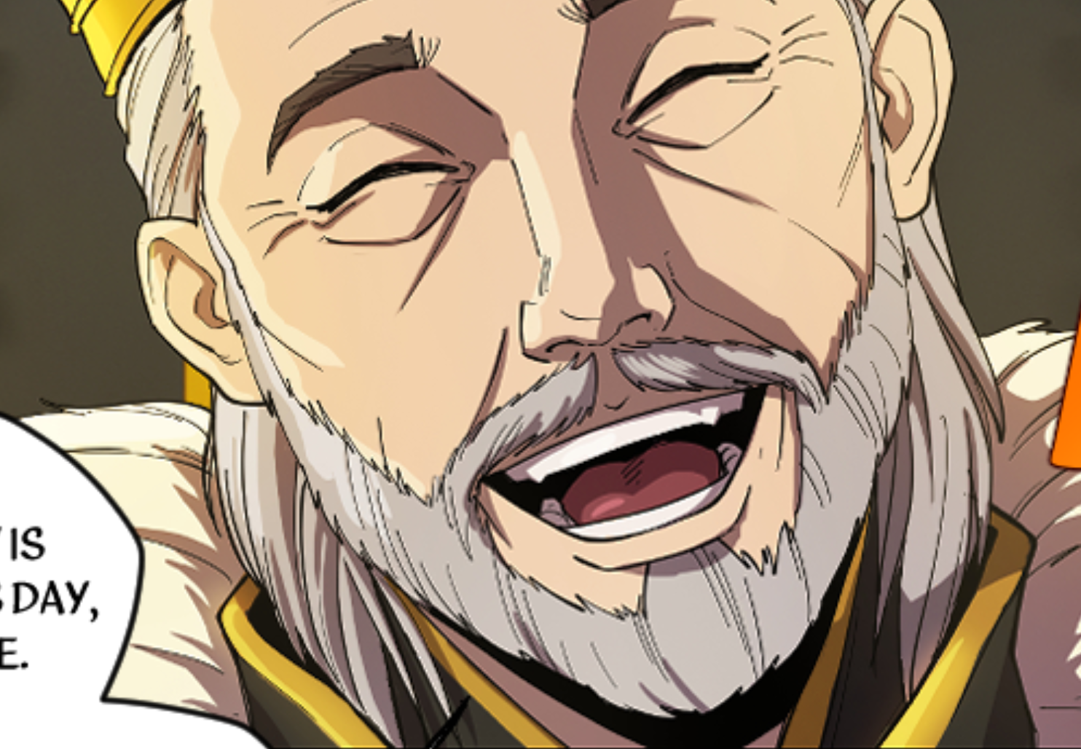
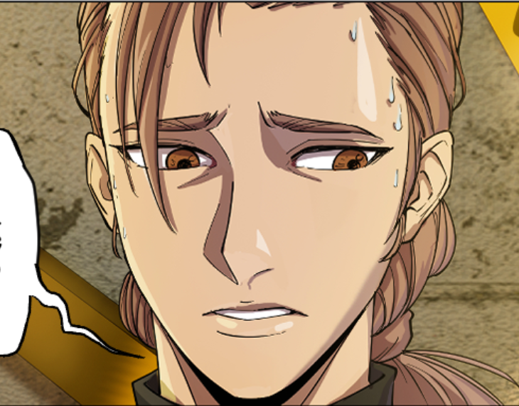
Character Design
Black Bear
Huge, dangerous. Black Bear is a cold murderer wanted by the authorities
Prince Julius
A spoilt prince who shamelessly
exercises his status on his subordinates.
King Elbert
A wise King, loved by his people. Unfortunately his son, Julius, is nowhere near him
Jasper
Once a trusted jester, but eventually plots to kill the wise King

Slide 10
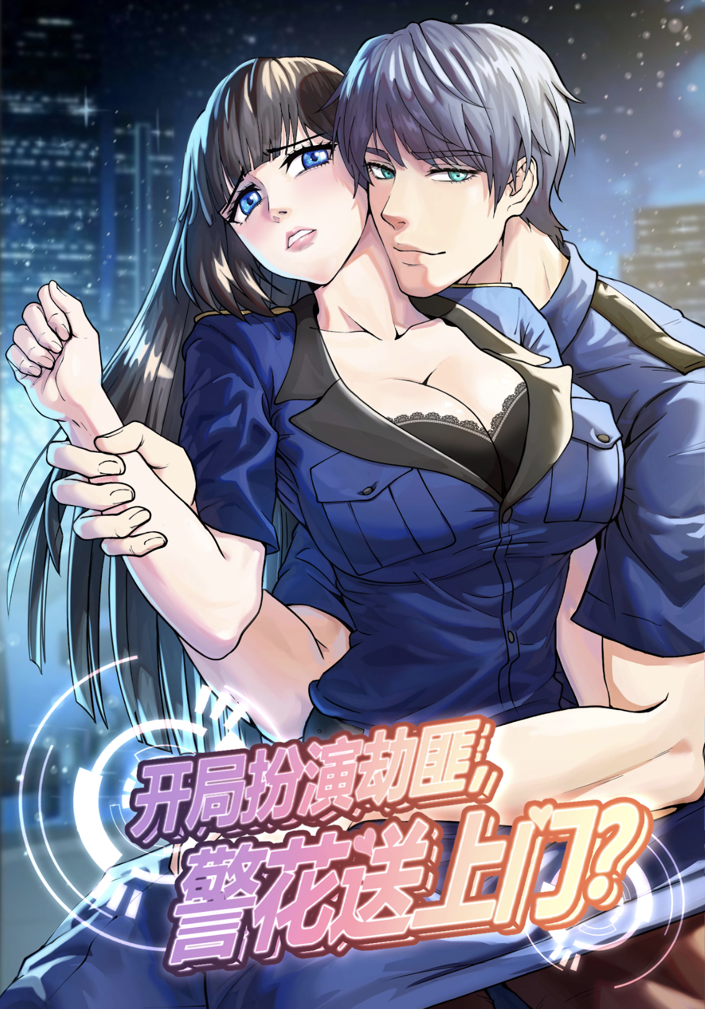
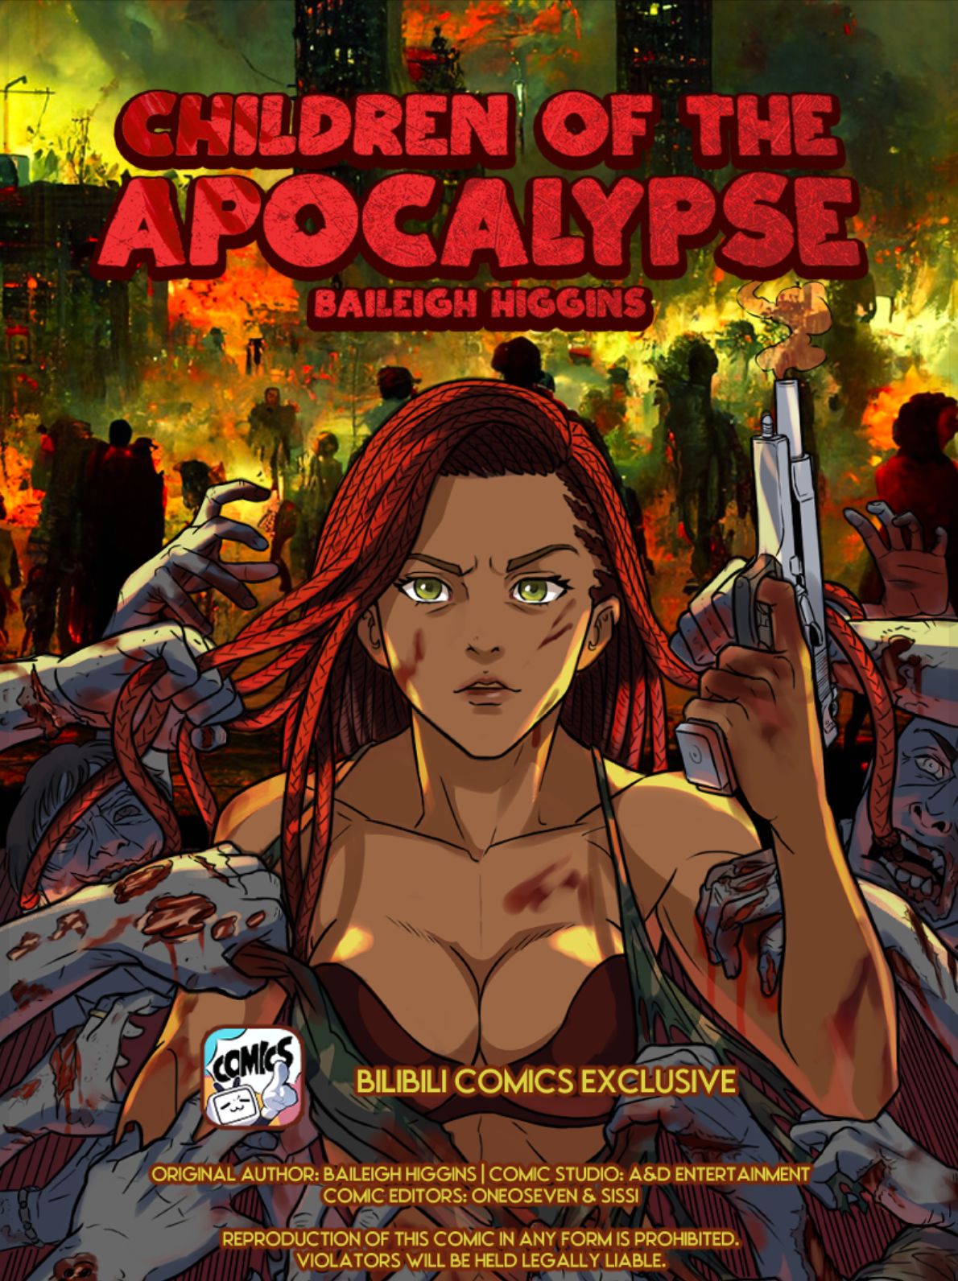
Published Titles
Inter Dimensional Police
Published : 2023
Platform : Bilibili Comics
Service:
Novel - Script - Char Design - Storyboarding - Lining - Coloring - Bubbling
My Best Pet Turtle
Published : 2023
Platform : Bilibili Comics
Service:
Novel - Script - Char Design - Storyboarding - Lining - Coloring - Bubbling
Children of the Apocalypse
Published : 2022
Platform : Bilibili Comics
Service:
Novel - Script - Char Design - Storyboarding - Lining - Coloring - Bubbling

Slide 11
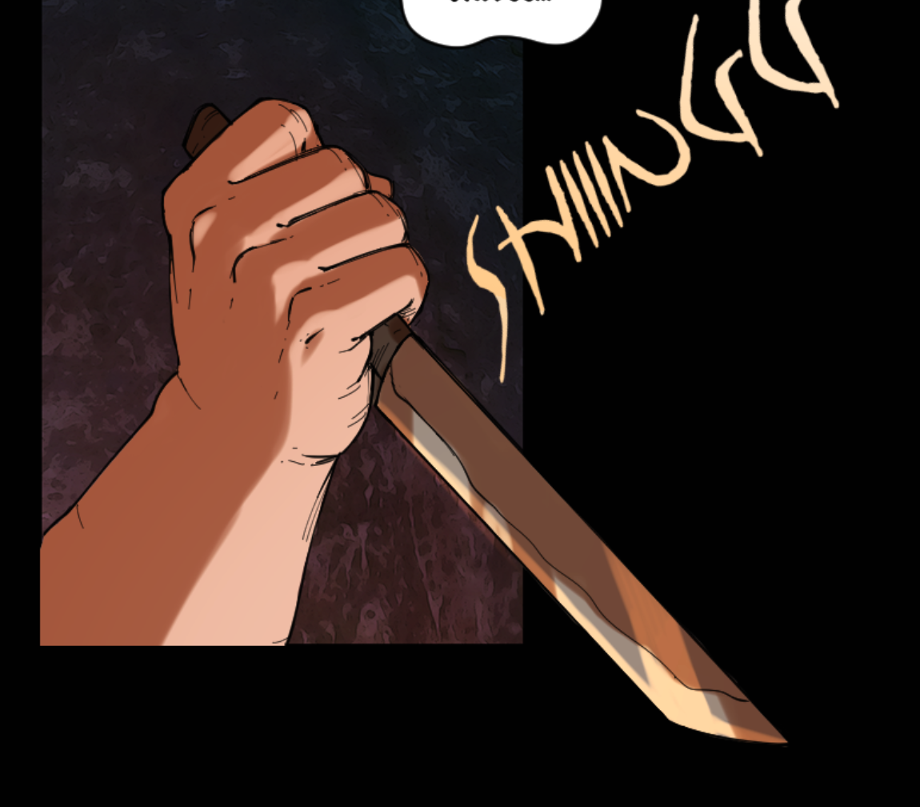
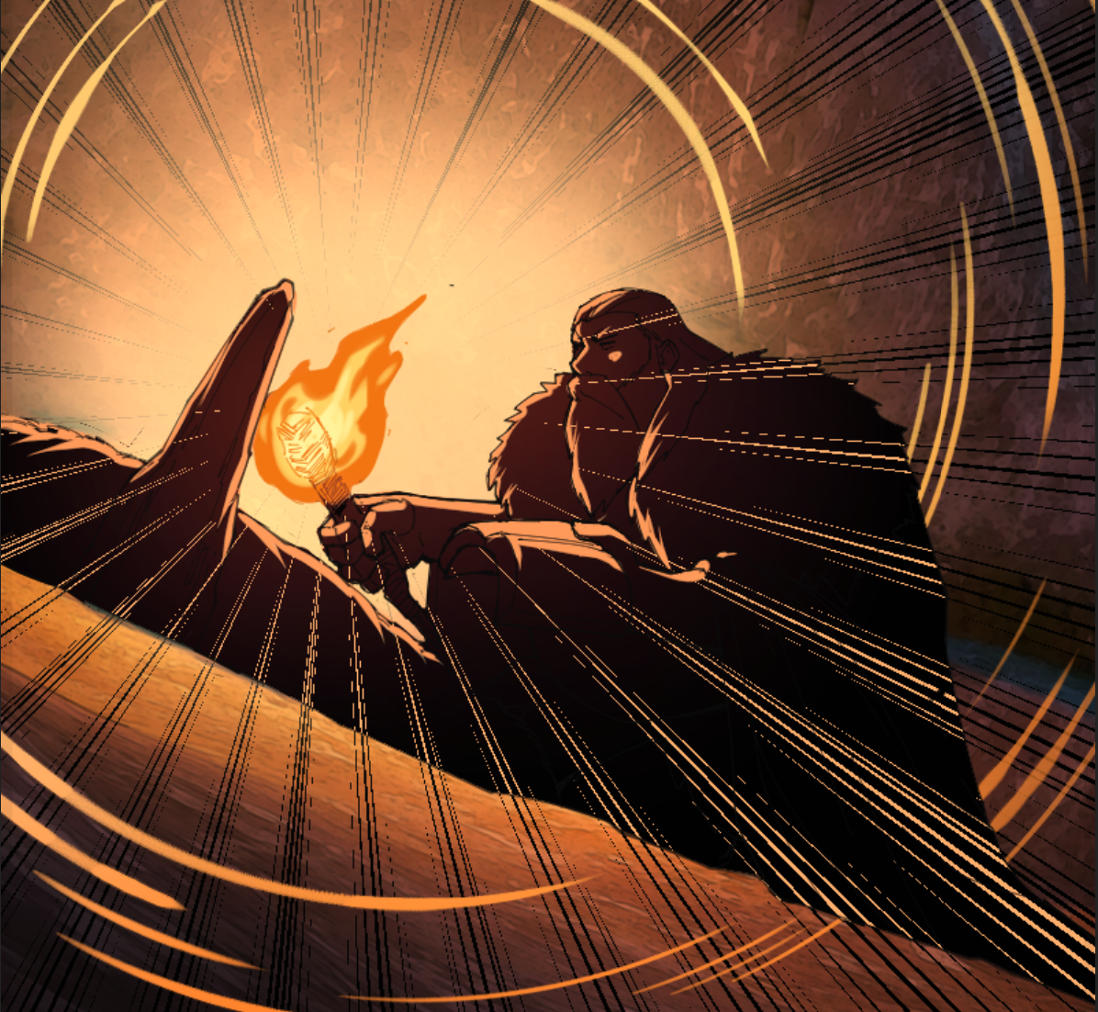
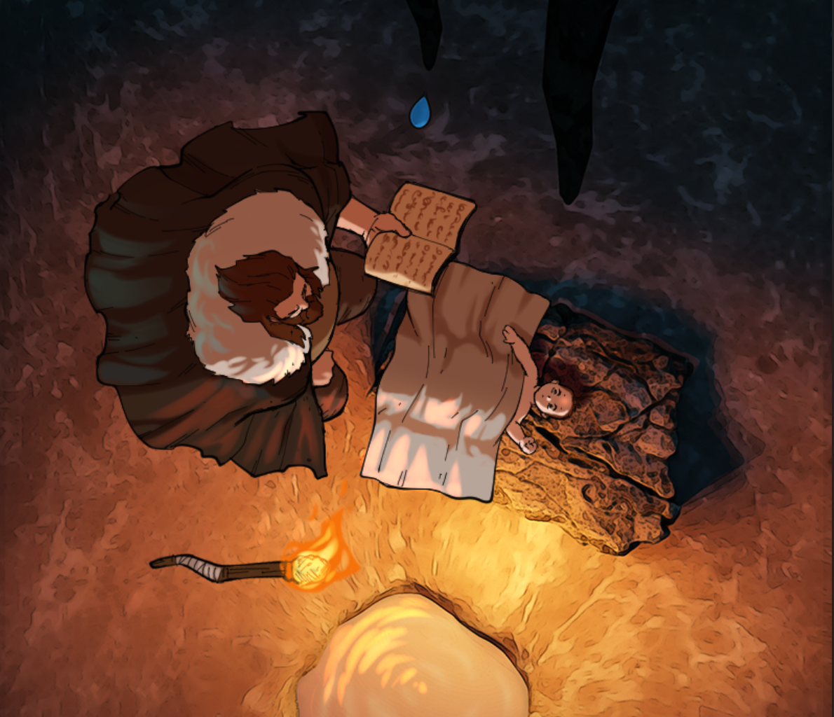
Highlights

Slide 12
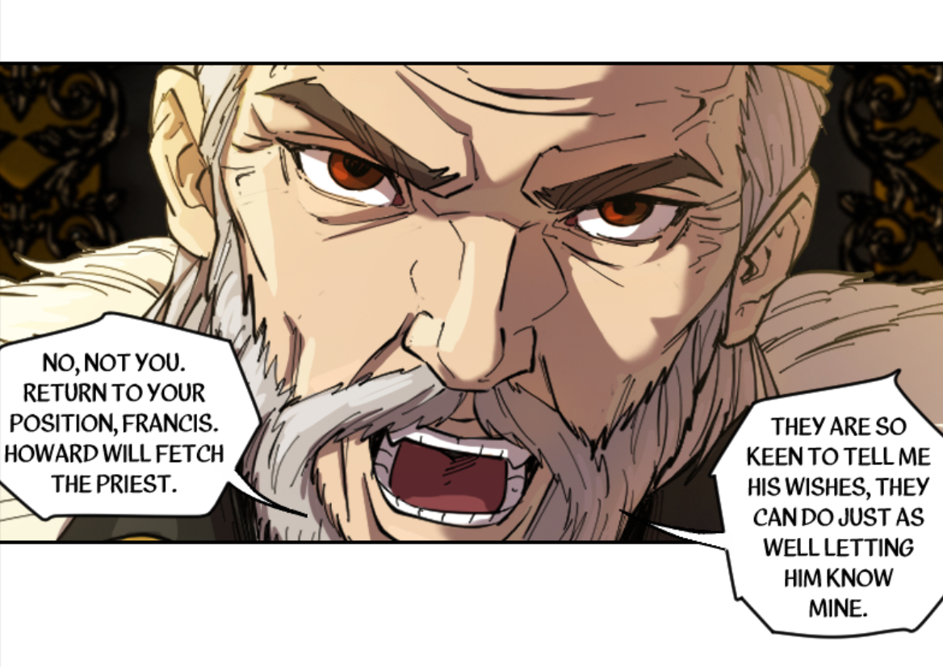
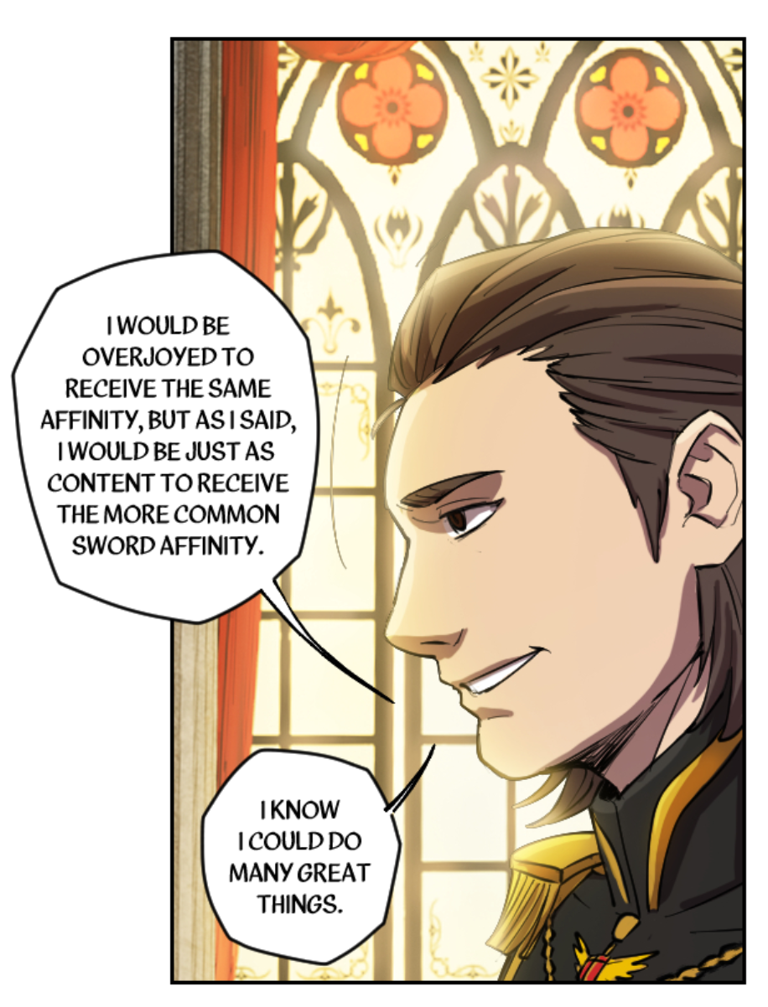
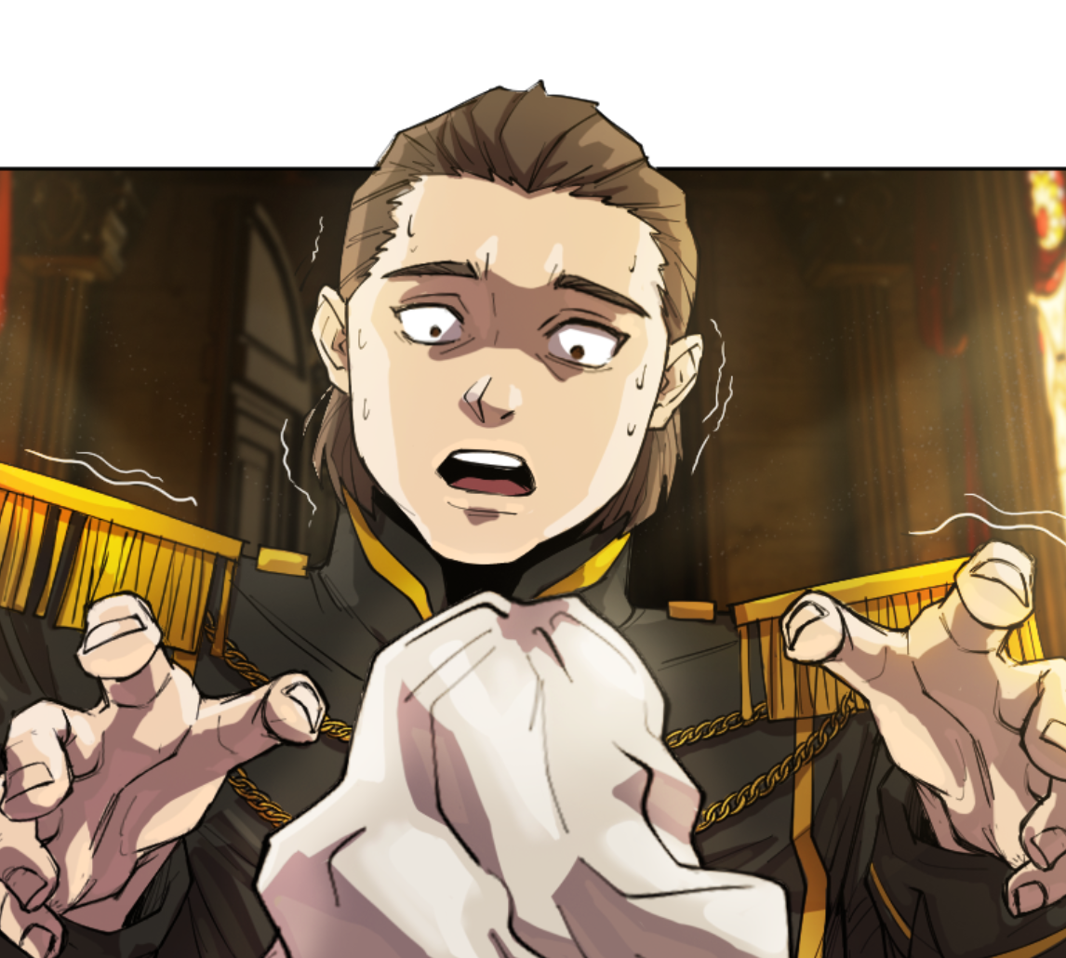
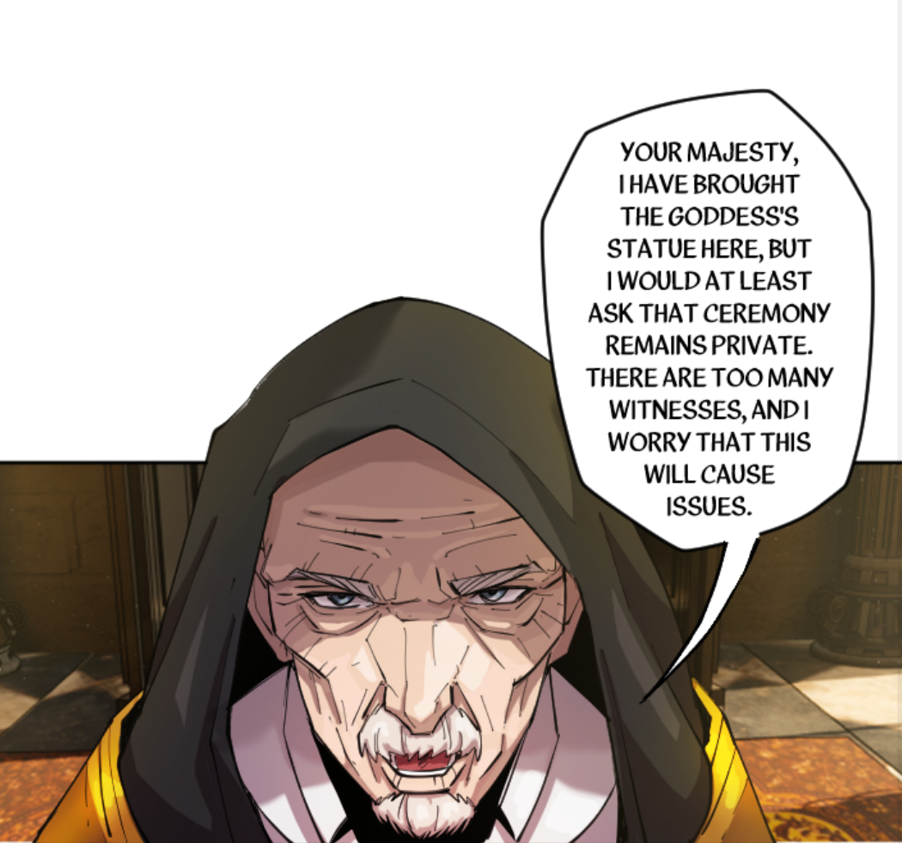
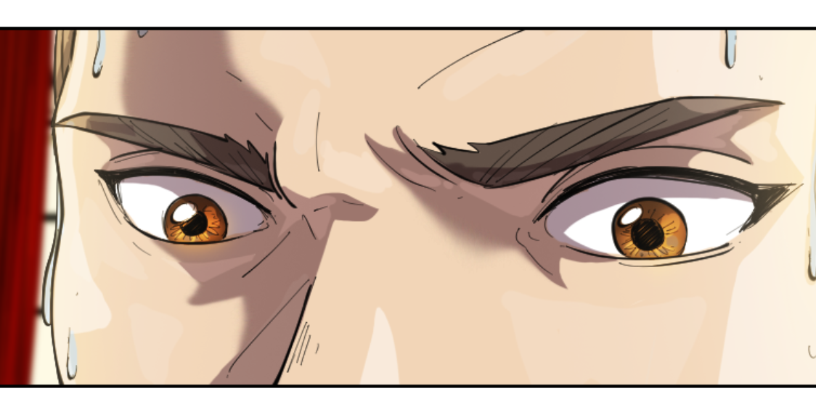
Highlights

Slide 13
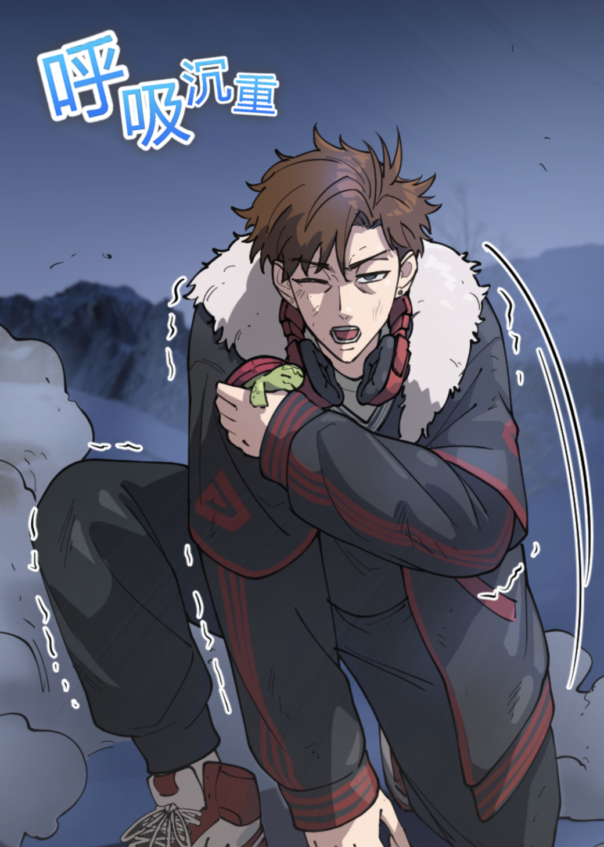
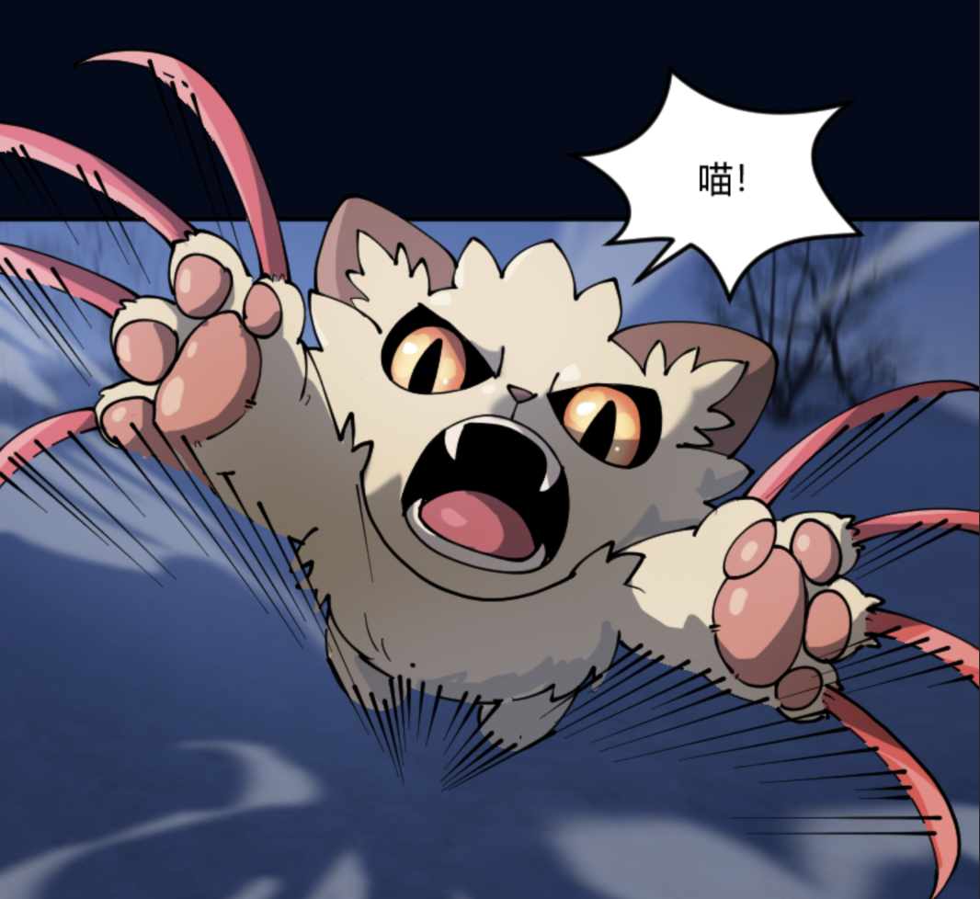
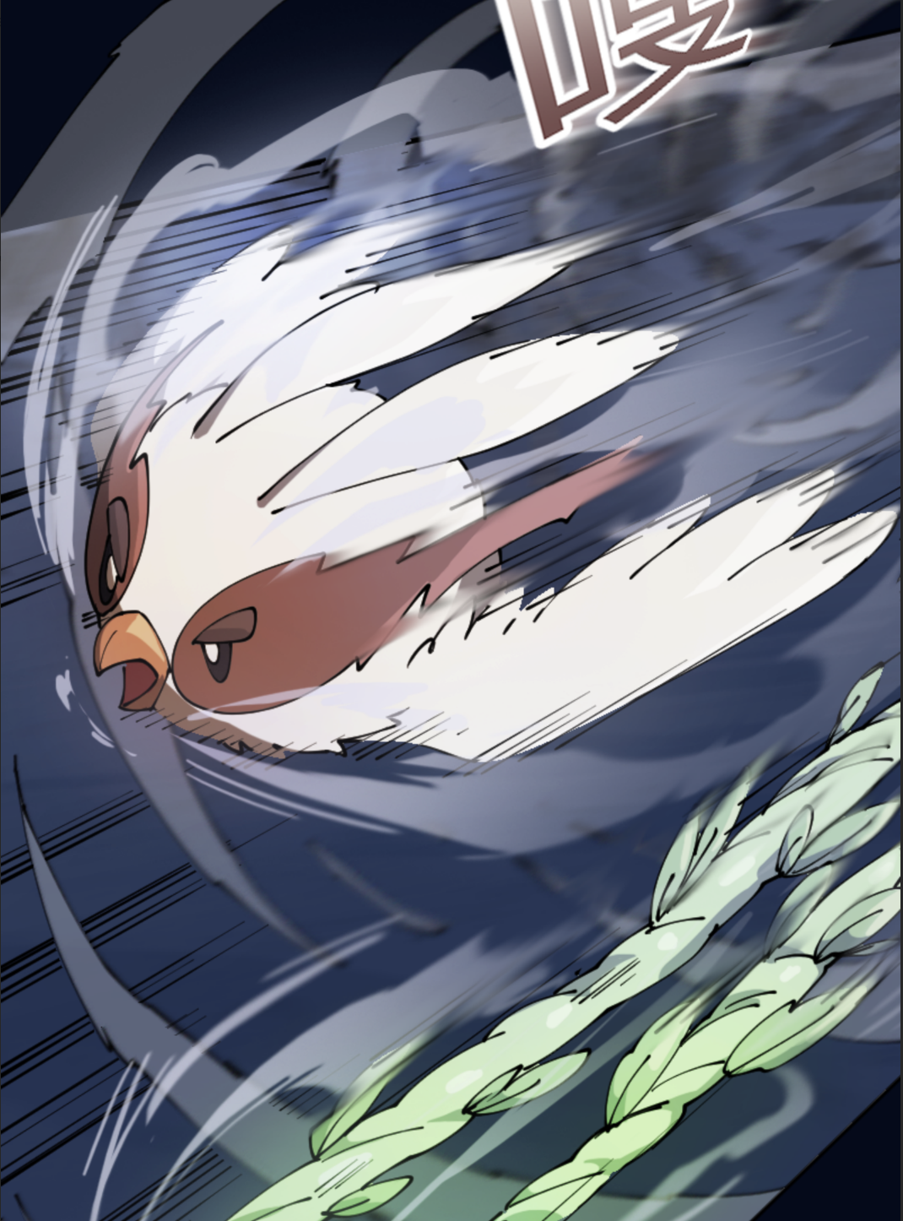
Highlights

Slide 14
03 |
Novel Translation process
Novel Translation
Production Process
Source Language → Target Language
Translate
by Translator
Checking
by Editor
Final Check
by Chief Editor
Check
with the Client
Naming Consistency & Polishing Language Art for Local Slang & Trends

Slide 15
02 |
COMIC translation process
ComicTranslation
Production Process
Source Language → Target Language
Input
Redrawing, Typesetting & Finishing
Cleaning Up
the chapter
Translate
by Translator
Check
by Editor
Final Check
By Chief Editor

Slide 16
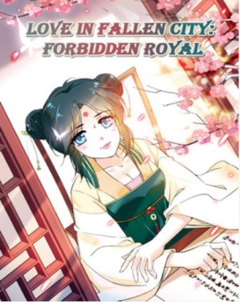
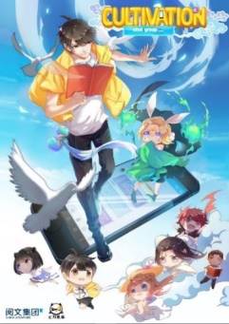
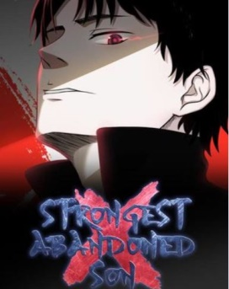
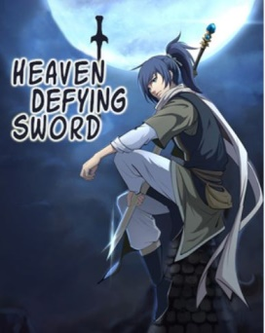
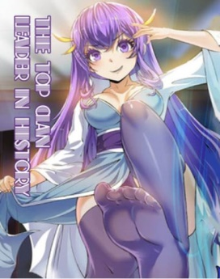
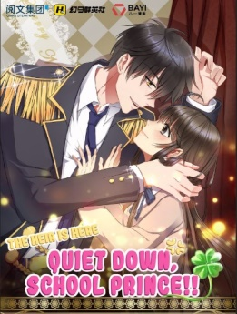
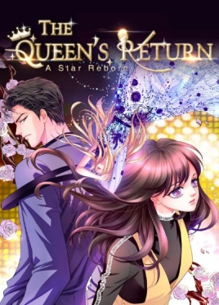
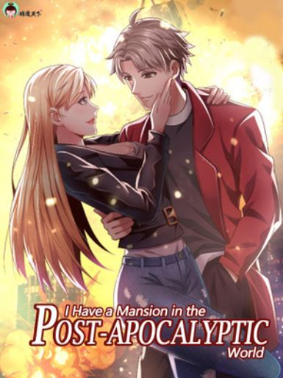
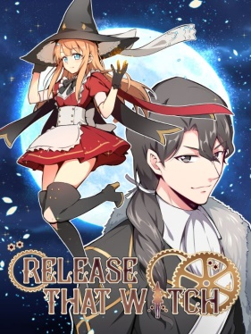
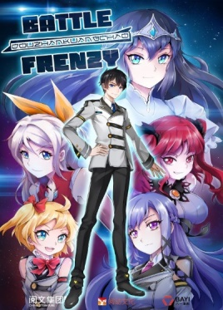
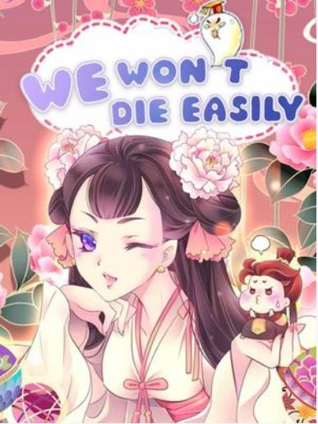
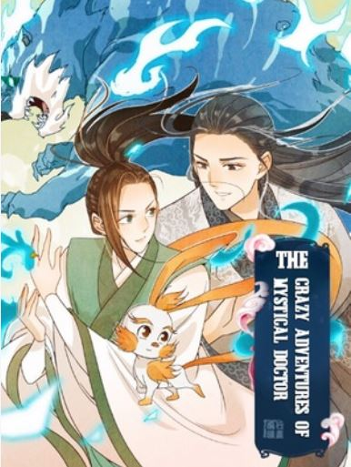
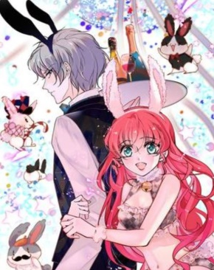
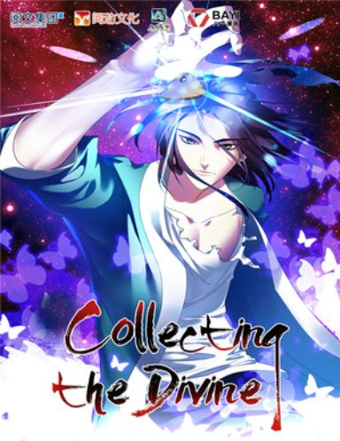
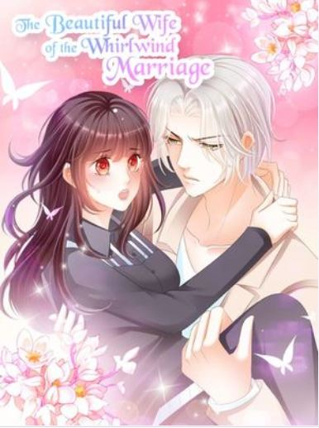
03 |
Comic and Translation List
C
O
M
I
C
& MANY MORE

Slide 17
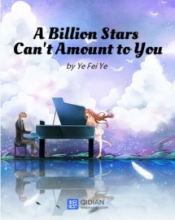
03 |
Comic and Translation List
N
O
V
EL
& MANY MORE

Slide 18
Thank You
Contact Us
Business Inquiry:
Sanjaya Wahono
Sanjaya@wavegame.net
swahono@gmail.com
WA: +62 856 4817 8871
Skype:Sanjaya.wahono
Wechat ID: sanwa83

